Slide 1
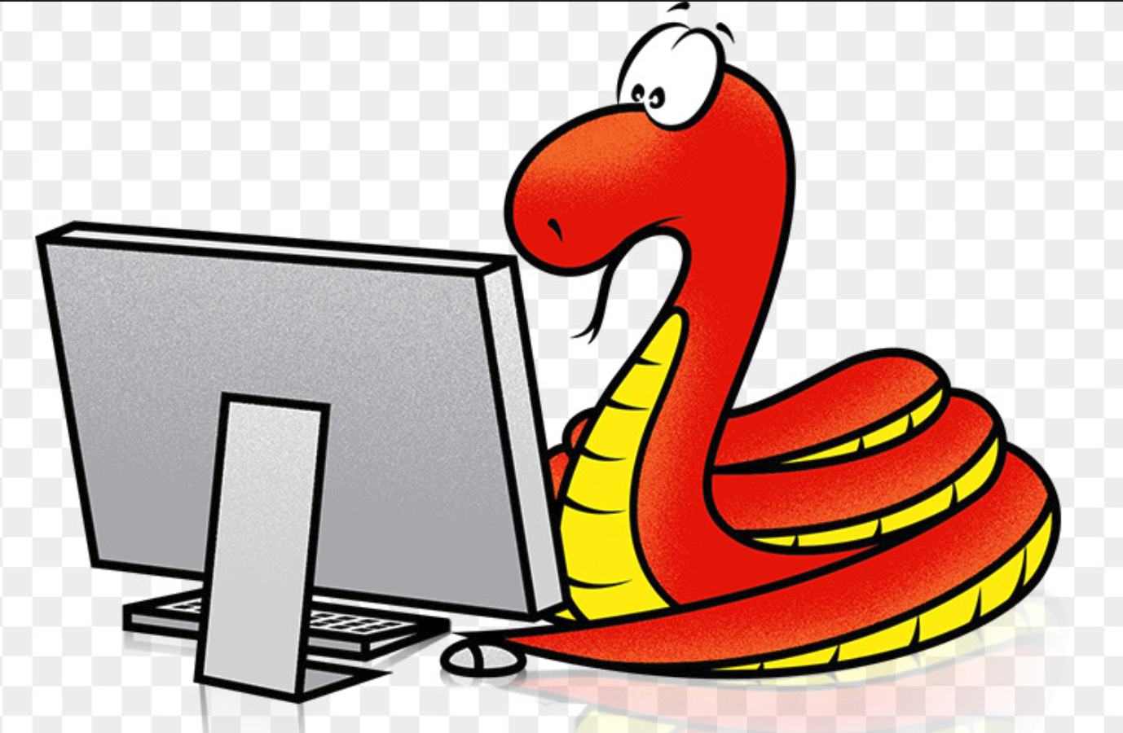
Python Bytes Welcome!
Featuring CS Wonders by Dr. Tao Wei
Developed through Tyee PTSA
Annie Zhu, Rob Fatland co-chairs
tyeepythonbytes@gmail.com
Registration: http://tyeeptsa.org

Slide 2
Why?
To understand our world
To study and understand processes
To be able to ask questions about the influences on our lives
To use an important new form of literacy
To have a new way to learn art, music, science and mathematics
As a job skill
To use computers better
As a medium in which to learn problem solving

Slide 3
Two Asks
Prepare your student to succeed by giving them the time and space to work on PB at home
Review your student's work, progress, and Byte Sheets. The more engaged you are…

Slide 4
Club Structure
Coaches
3:35 to 5:00 Room 1308 Tuesdays
Cancellations will be announced: Morning, TTimes, email
‘How do I get help outside of club time?’
Search bar
Email
Python Byte Sheets: 1 page, 15 minutes, turn in as you arrive
Byte Sheet 0 is here (but optional)
Signed code of conduct is also due at Meeting 2

Slide 5
Code of Conduct
We are dedicated to providing a harassment-free learning experience for everyone, regardless of gender, sexual orientation, disability, physical appearance, body size, race, or religion. We do not tolerate harassment in any form, including offensive communication, suggestive or explicit images, harassing media of any form, deliberate intimidation, following, disruption of people speaking, inappropriate physical contact or unwelcome attention.
Be kind to others. Do not insult or put down other participants. Behave professionally. Remember that sexist, racist, or exclusionary jokes are not appropriate.
People asked to stop any harassing behavior are expected to comply immediately. Anyone violating these rules may be asked to leave the classroom at the sole discretion of the instructors and coaches.
If you believe someone is violating the Code of Conduct we ask that you report it: Either by speaking to us (coaches, parents, teachers), by email or if necessary by phone or text. All reports will be kept confidential.
Thank you for helping make this a welcoming, friendly event for all.

Slide 6
Segue to Dr. Tao

Slide 7
Python Bytes Intermediate
Rob Fatland, Tao Wei, Annie Zhu, Wei Lu

Slide 8
Meru Prastarah
…the (early) name for the Pascal Triangle
combinatorics, graph theory, algebra, calculus, fractals, …

Slide 9
Ocean Data Science
As I dive down into the Pacific ocean: Does the water get warmer?

Slide 10
Minecraft
setBlock(x, y, z, type)

